Slide 1
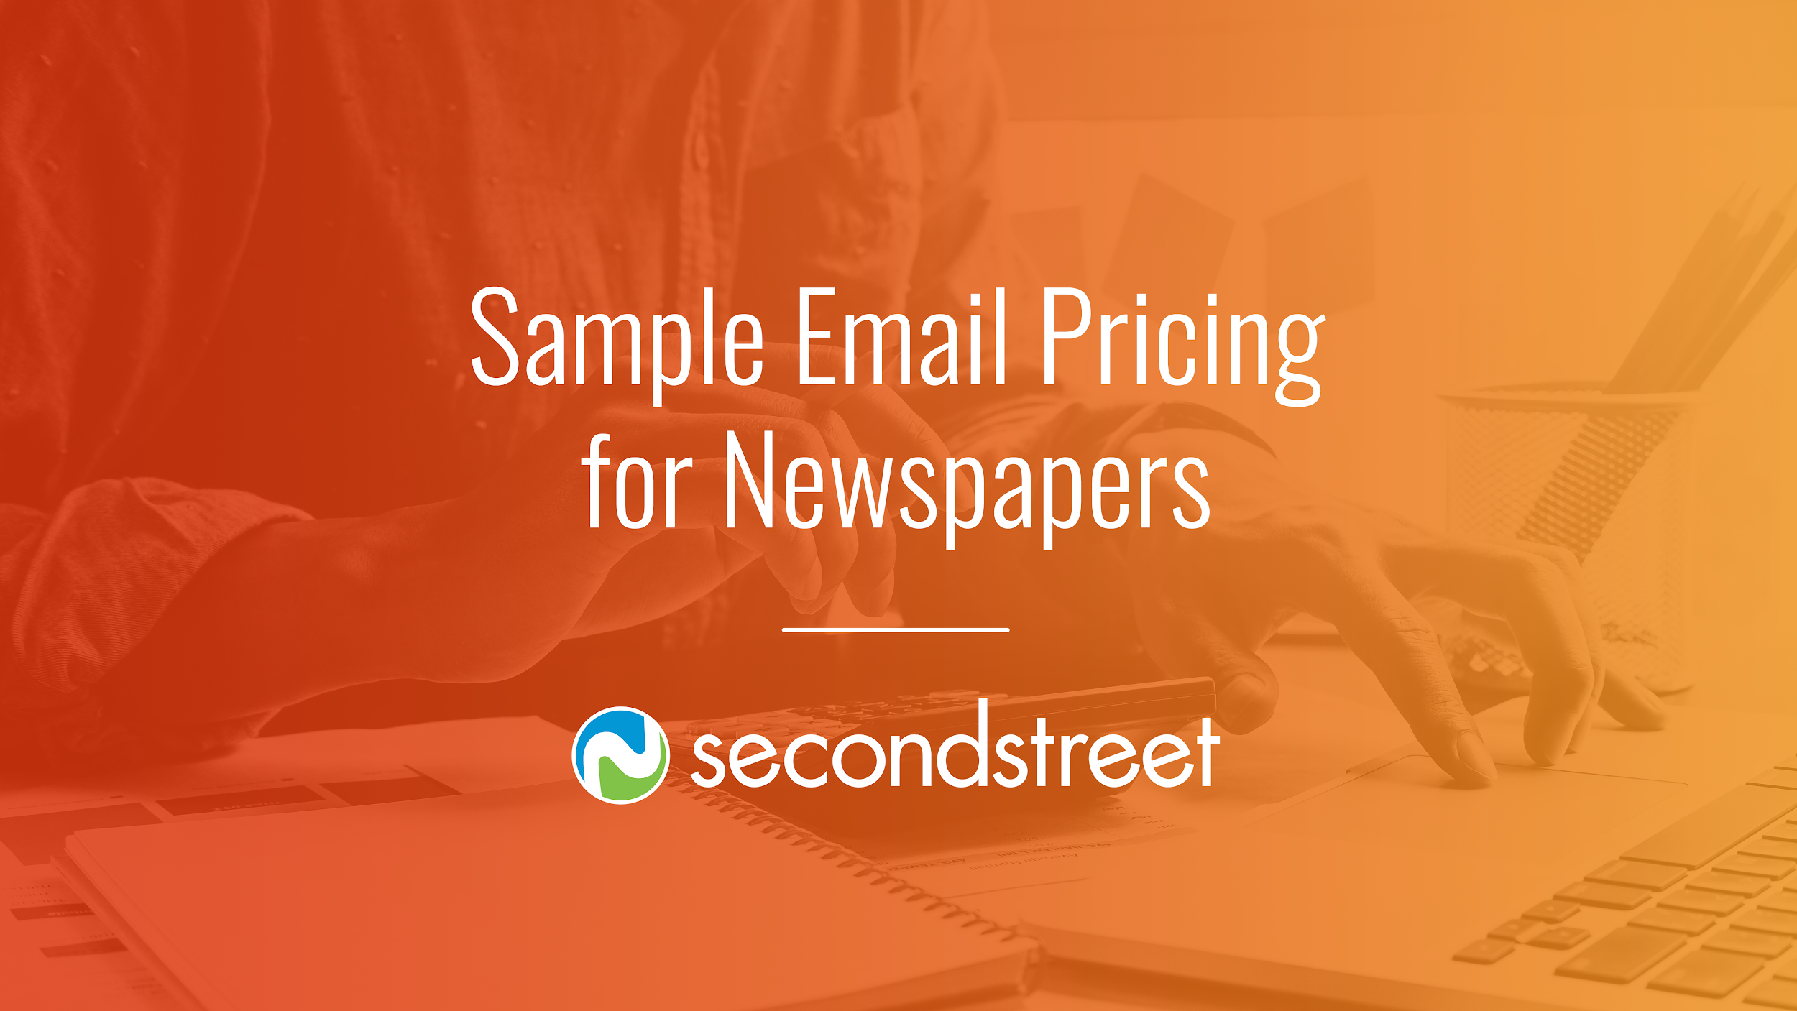
TV
Sample Email Pricing

Slide 2
How to Use These Samples
In this deck, you will find a variety of customizable sales packages you can use to build out various email sponsorship packages.
This document has been created using suggestions for a mid-size market with an email list size of 20,000+. These are baseline packages for you to customize, so feel free to add or subtract elements based on what your company can provide.

Slide 3
Table of Contents
Newsletters …………………………………………………….... Slide 4
Birthdays & Anniversaries ….…………...…….……...…. Slide 8
Promotions Emails …………..………….……………....… Slide 13
Dedicated Emails ……………………….……………....…. Slide 15

Slide 4
Newsletters

Slide 5
Individual Daily Newsletter Sponsorship (Limit 1)
Single Sponsor of a Specific Daily Newsletter
Daily Newsletter Sponsorship Custom banner ad placed prominently within newsletter Email delivered to average X list with a consistent X% open rate
Investment for a mid-size market: $1,500-$3,000/month

Slide 6
Individual Weekly Newsletter Sponsorship (Limit 1)
Single Sponsor of a Specific Weekly Newsletter
Weekly Newsletter Sponsorship Custom banner ad placed prominently within newsletter Email delivered to average X list with a consistent X% open rate
Investment for a mid-size market: $500-$1,500/month

Slide 7
Topic Newsletter Sponsorship (Limit 1)
Single Sponsor of Specific Newsletter and Related Content
Newsletter Sponsorship Custom banner ad placed prominently within newsletter Email delivered to average X list with a consistent X% open rate
Print Campaign including: 3 col. X 10” promotional ads (3 total) 1 Sunday ½ page promotional ad
Digital Campaign including: 25,000 728×90 ROS impressions
Social Campaign including: Mentions on Facebook & Twitter at least once a week
Investment for a mid-size market: $4,000-$10,000/month

Slide 8
Birthdays &
Anniversaries

Slide 9
Birthday Club Sponsorship (Limit 1)
Single Sponsor of an Annual Birthday Club Newsletter
Pro Tip: Bundle a digital campaign, on-air elements, and social mentions for a larger client spend!
Birthday Club Sponsorship Advertiser’s logo and message displayed prominently in email Sponsor offer or coupon included in email Email delivered to average X list with a consistent X% open rate
Investment for a mid-size market: $2,000-$3,000/month

Slide 10
Birthday Club Sponsorship (2+ available)
Multiple Sponsors of an Annual Birthday Club Newsletter
Pro Tip: Bundle a digital campaign, on-air elements, and social mentions for a larger client spend!
Birthday Club Sponsorship Advertiser’s logo and message displayed prominently in email Sponsor offer or coupon included in email Email delivered to average X list with a consistent X% open rate
Investment for a mid-size market: $250-$750/month

Slide 11
Wedding Anniversary Club Sponsorship (Limit 1)
Single Sponsor of an Annual Wedding Anniversary Club Newsletter
Pro Tip: Bundle a digital campaign, on-air elements, and social mentions for a larger client spend!
Wedding Anniversary Club Sponsorship Advertiser’s logo and message displayed prominently in email Sponsor offer or coupon included in email Email delivered to average X list with a consistent X% open rate
Investment for a mid-size market: $500-$1,500/month

Slide 12
Promotions Emails

Slide 13
Promotion Follow-Up Campaign (Limit 1)
Sponsorship Package for Promotion Follow-Up Campaigns
Looking for pricing for Invite and Thank-You Emails? Download Our Promotions Pricing Guides Here!
Promotion Follow-Up Campaign Sponsorship Sequence of 3 custom emails sent over 3 weeks Exclusive advertising branding Email delivered to average X list with a consistent X% open rate
Investment for a mid-size market: $500-$1,500/3-email campaign

Slide 14
Dedicated Emails

Slide 15
Dedicated Targeted Email (Limit 1)
Sponsorship Package for a Dedicated Targeted Email Send
Dedicated Targeted Email 1 email sent to a targeted, interested database Email delivered to average X list with a consistent X% open rate
Investment for a targeted list below 5,000: $500 Investment for a targeted list above 5,000: $500 + $100/cpm over minimum

Slide 16
For more information about how to package and price email,
and even more about the sales process, visit
lab.secondstreet.com

