Slide 1
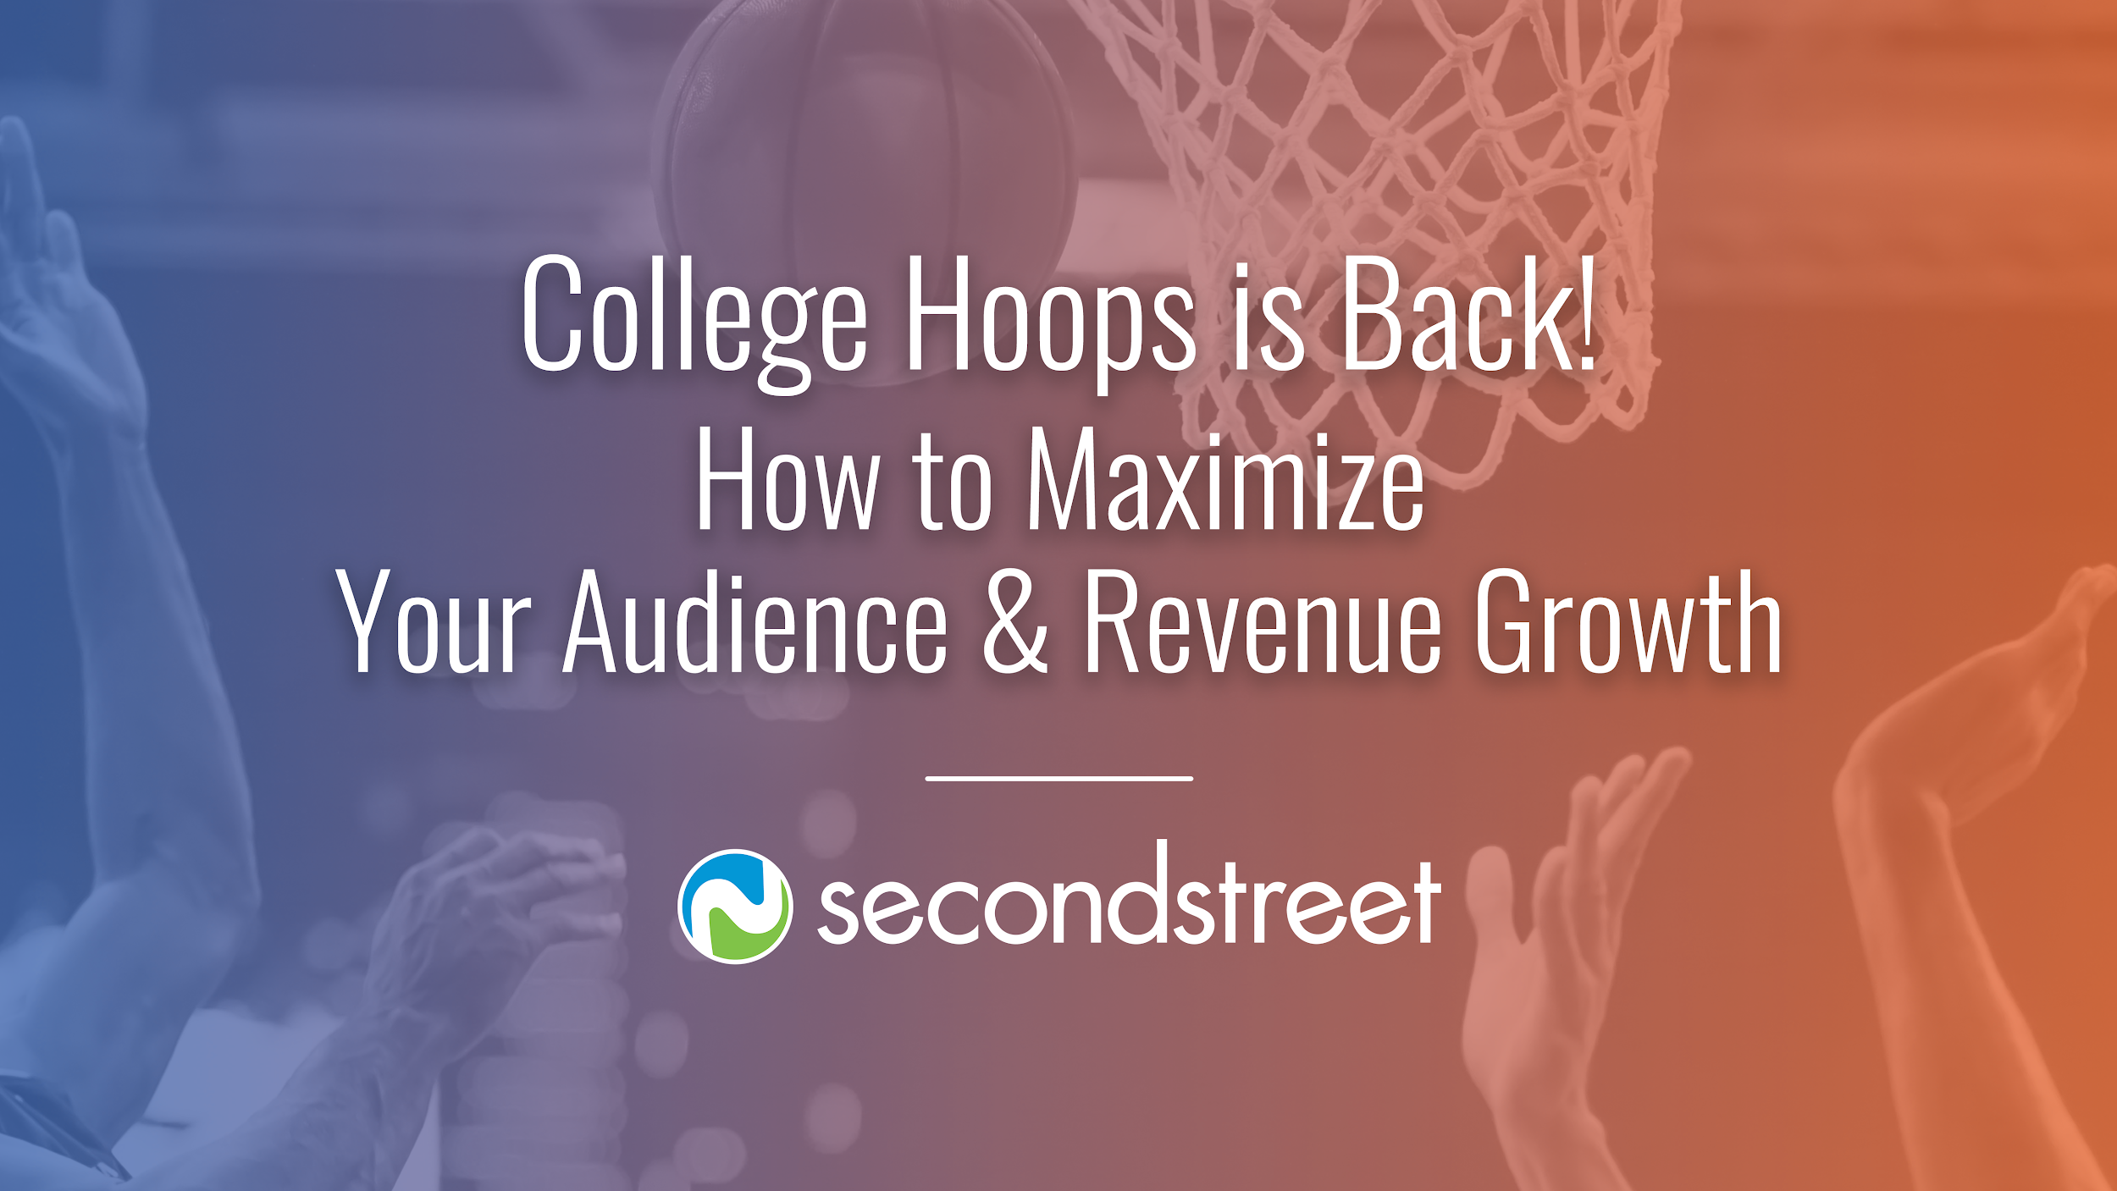

Slide 2

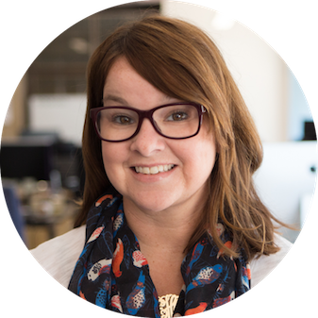
Welcome!
Liz Huff
Julie Foley
Director of Affiliate Success
Director of Affiliate Success
liz@secondstreet.com
julie@secondstreet.com

Slide 3
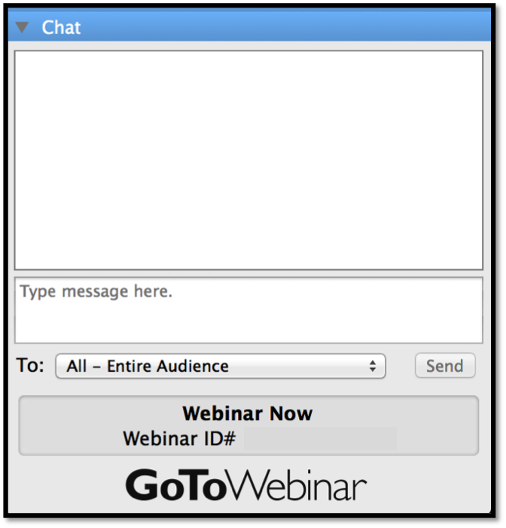
Questions?
Do you have questions?
Ask in the GoToWebinar panel during the webinar, and we will answer them at the end!
#secondstreetlab @secondstreet

Slide 4
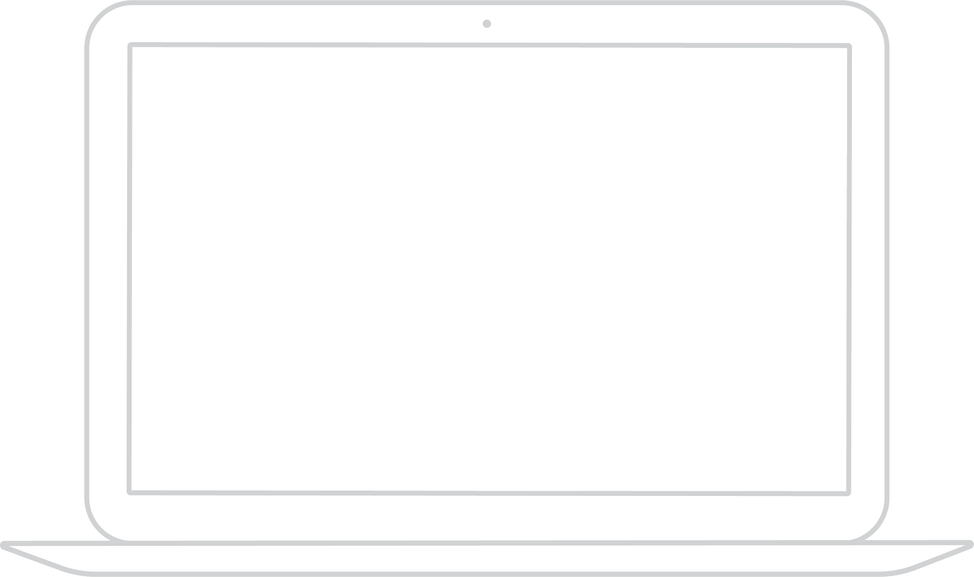
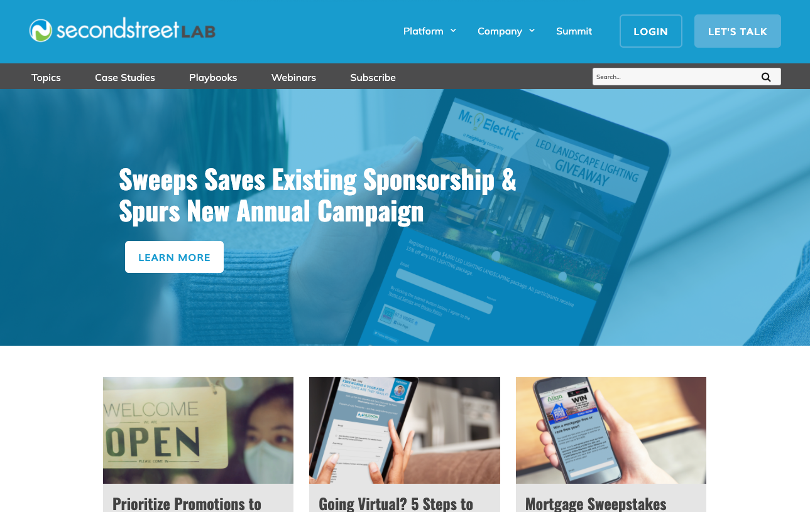
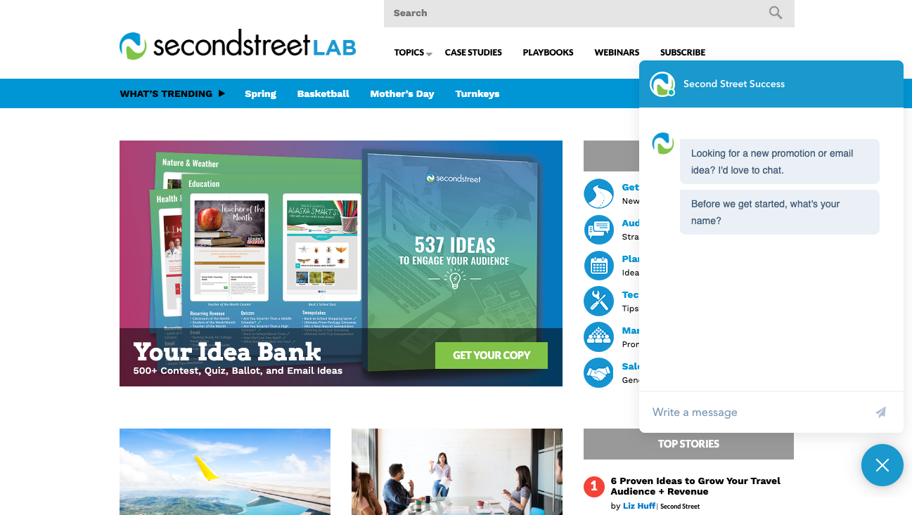
Chat NOW with Success!
lab.secondstreet.com
9 am - 5 pm CT, Monday through Friday

Slide 5
What We Know

Slide 6
There is pent up demand

Slide 7
College Hoops Dates:
Friday March 19, 2021 – Monday April 5, 2021

Slide 8
College Hoops Refresh

Slide 9
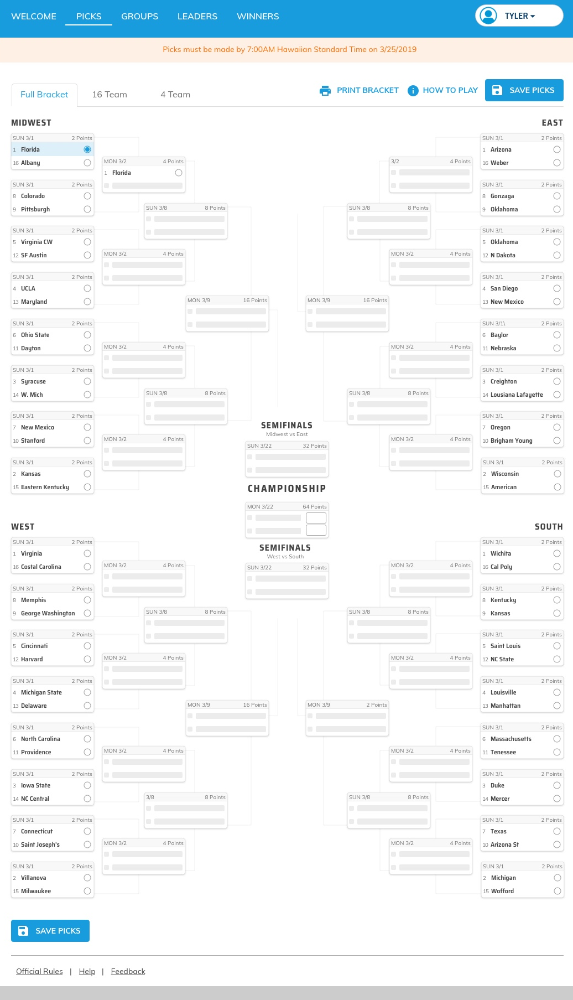
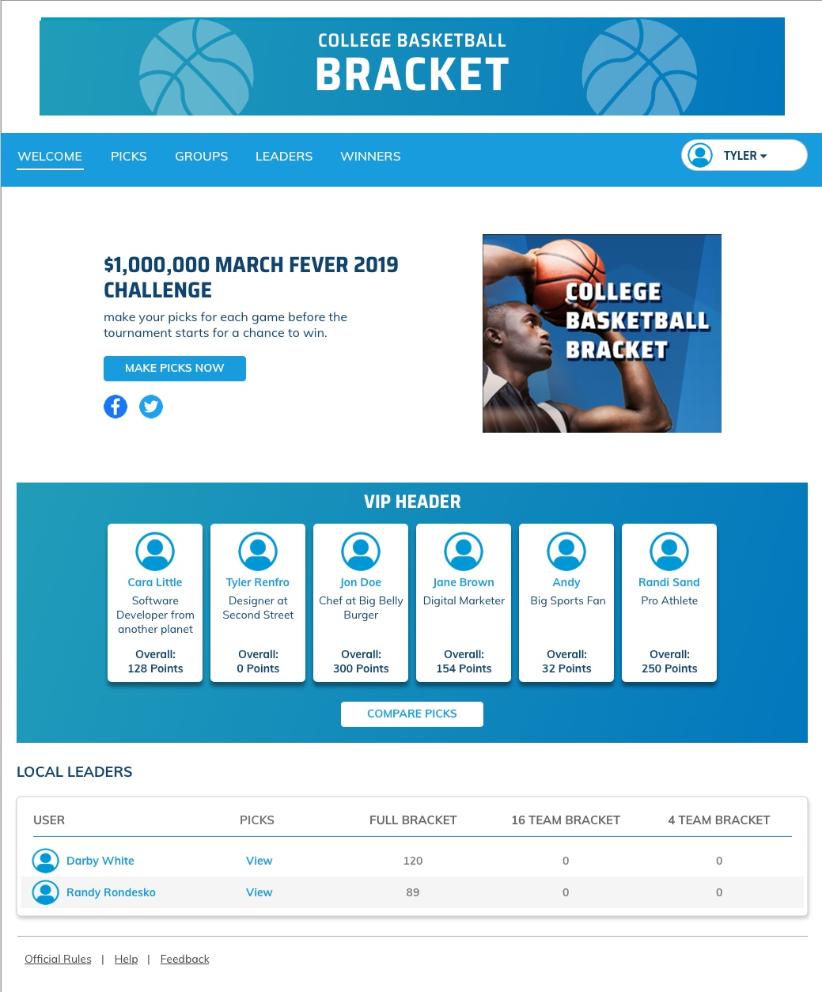
College Hoops Bracket
New updated look!

Slide 10
How the 3-in-1 Bracket Works

Slide 11
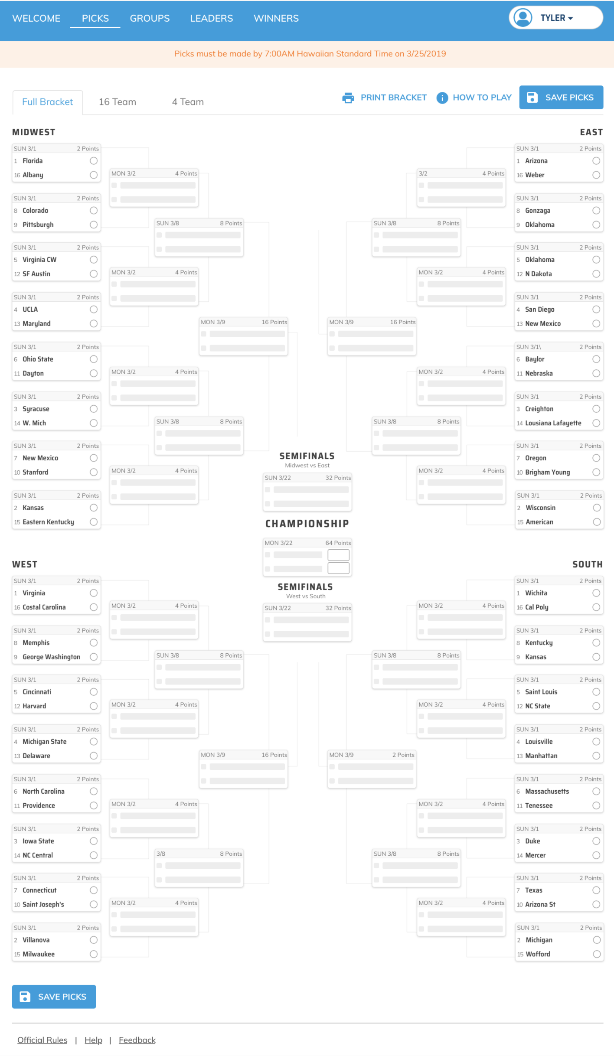
3 Games in 1
Separate 64, 16, and 4 team pick’ems (brackets)
One registration
Customizable - run what you want
More chances to play

Slide 12
3 Games in 1
64 Team Bracket

Slide 13
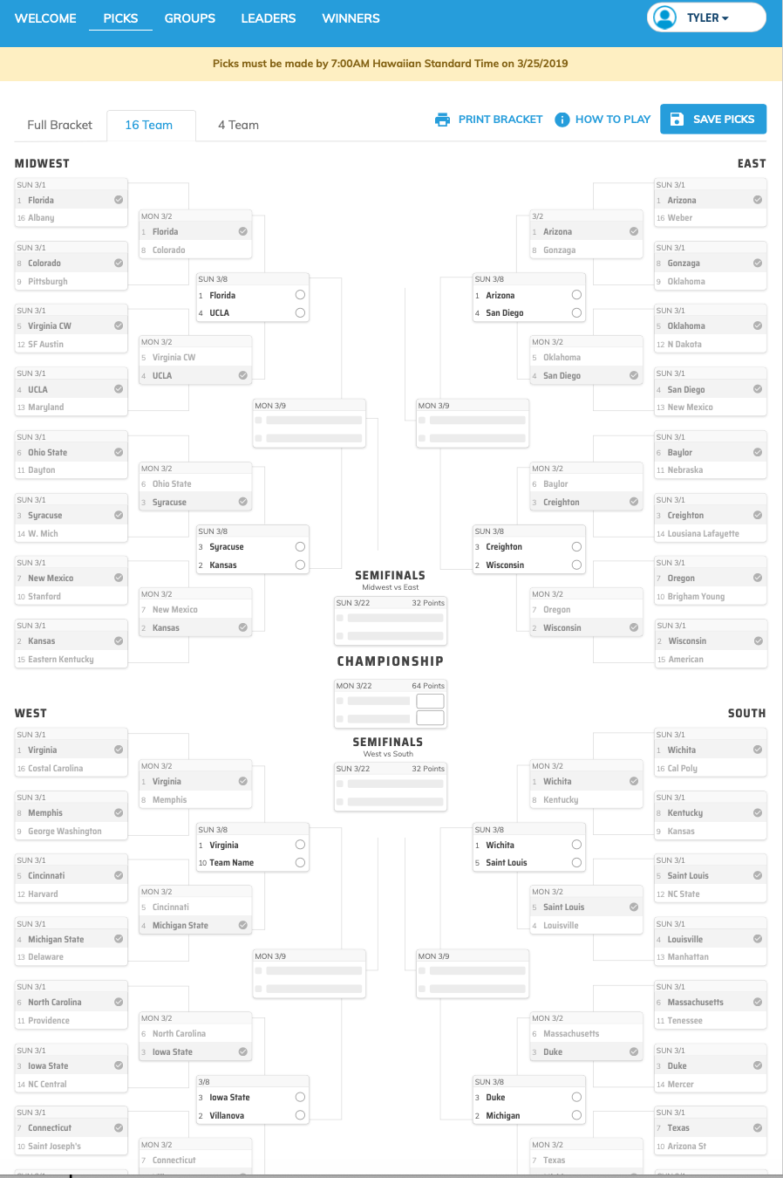
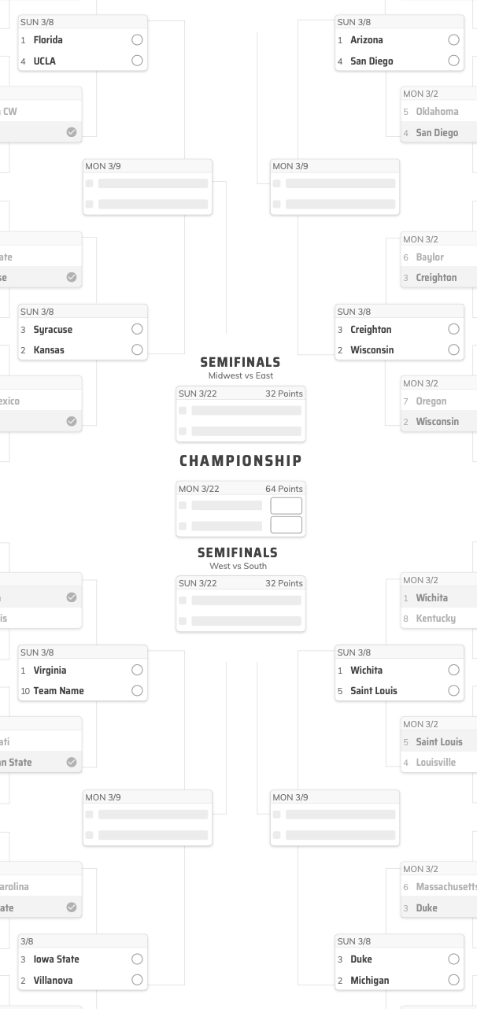
3 Games in 1
16 Team Bracket

Slide 14
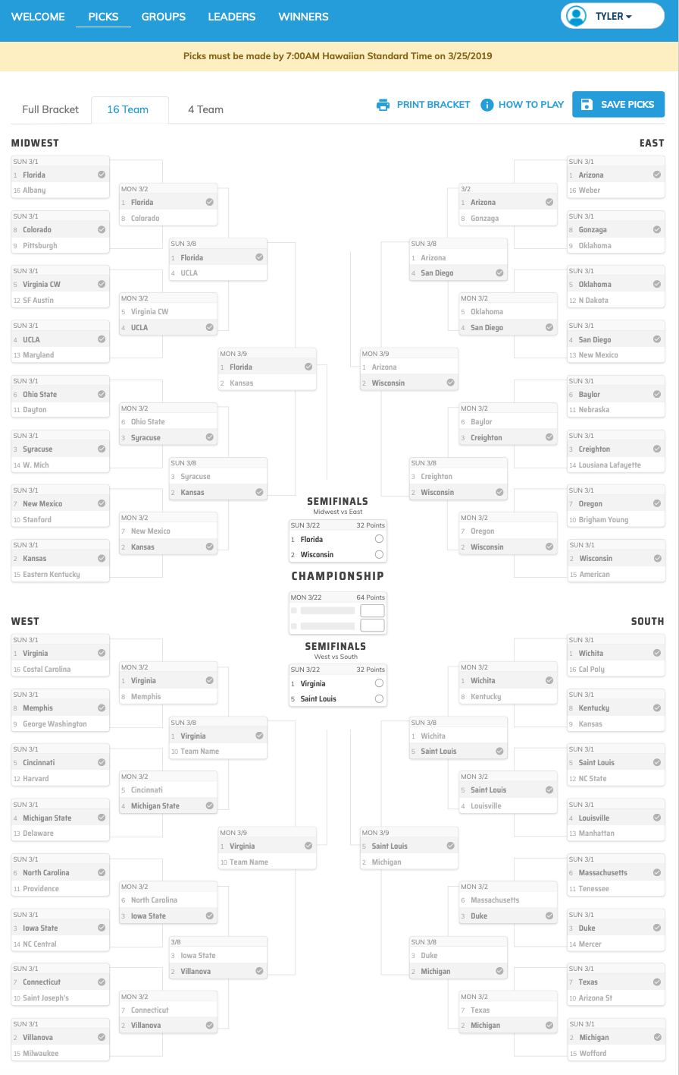
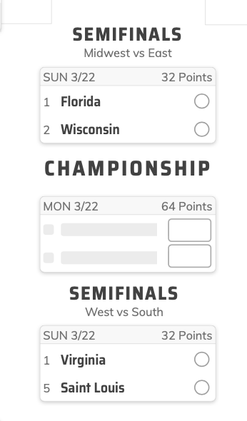
3 Games in 1
4 Team Bracket

Slide 15
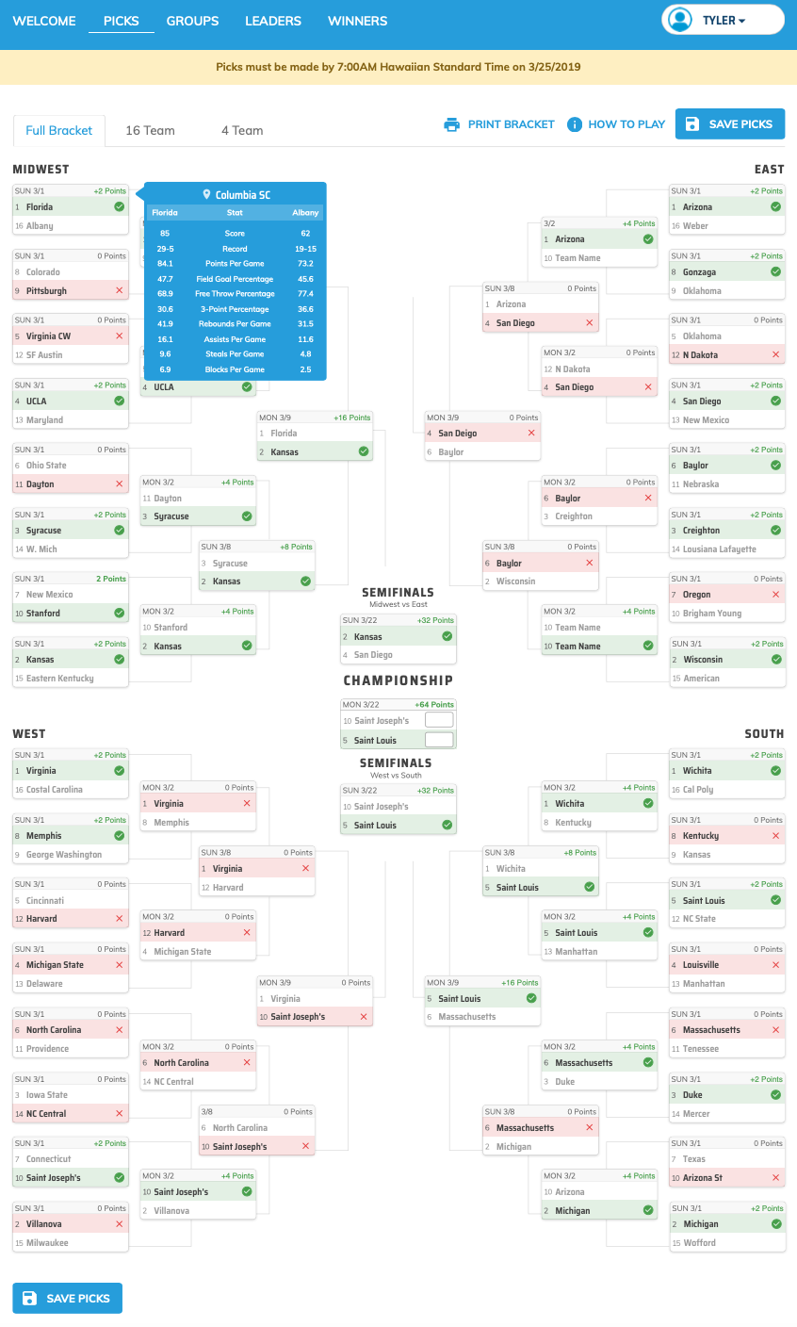
3 Games in 1
Bracket is Managed by Second Street - you will see updates on the bracket as the game scores come in!

Slide 16
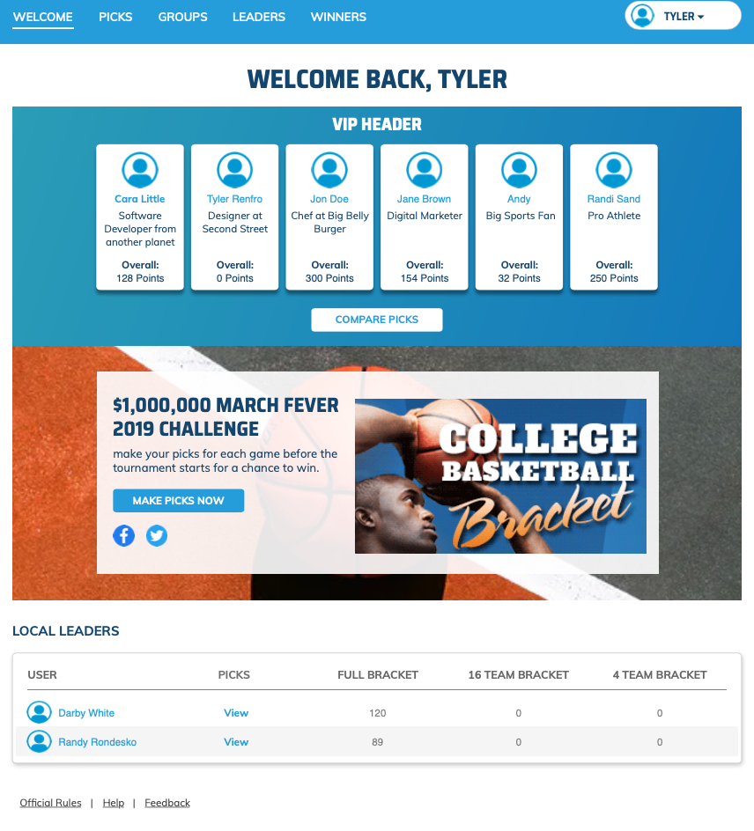
VIP Pickers
Welcome Page with VIP Pickers

Slide 17
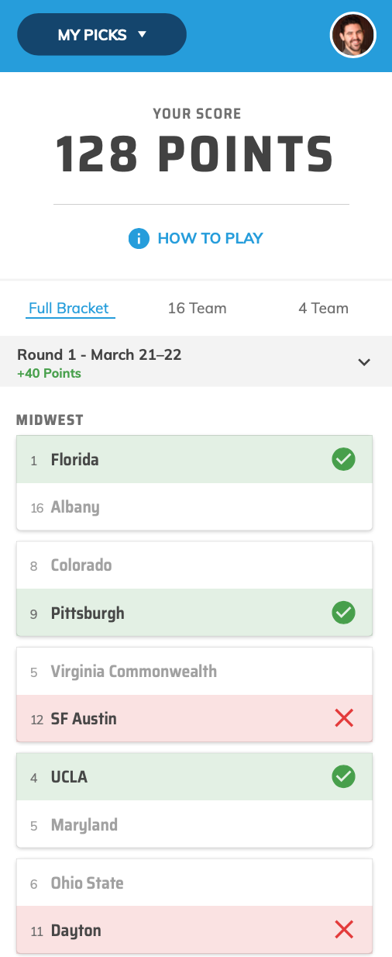
Make Picks
Make your picks for each round

Slide 18
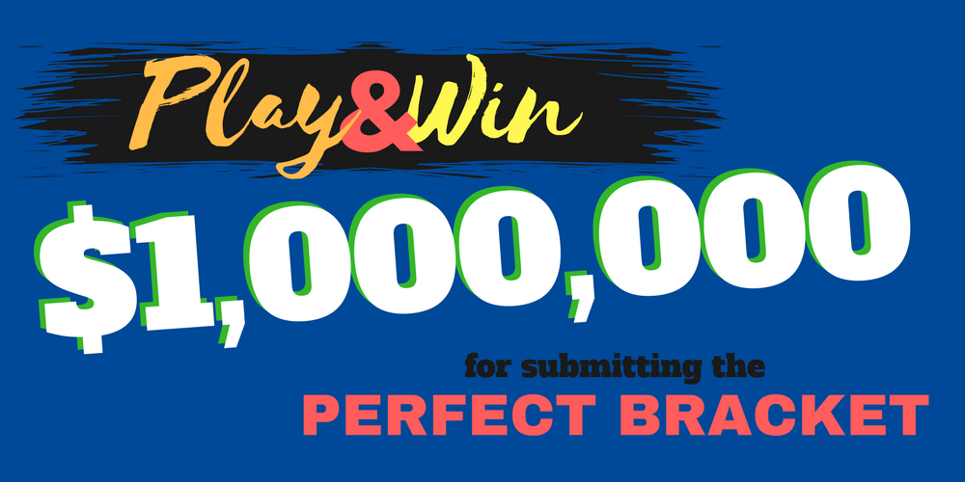
National Prizes

Slide 19

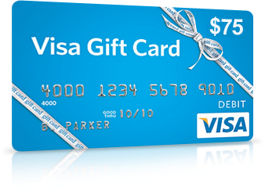
National Prizes
PS5
$75
Visa Gift Cards

Slide 20
What Should Your College
Hoops Plan Include?

Slide 21
Bundle Promotions

Slide 22
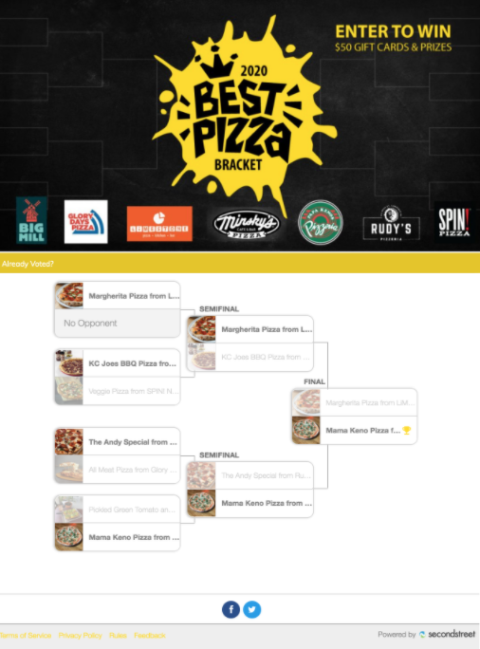
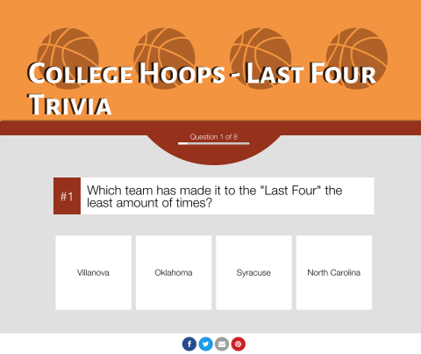
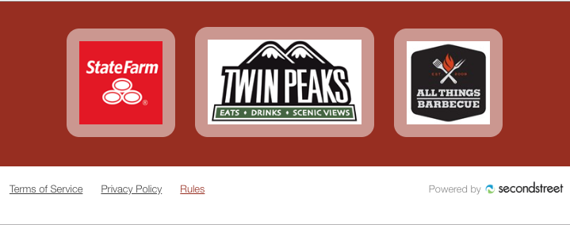
Bundle Promotions
College Hoops Bracket + Voting Bracket + Quiz

Slide 23
If you bundle, you have something
to fall back on to retain revenue

Slide 24
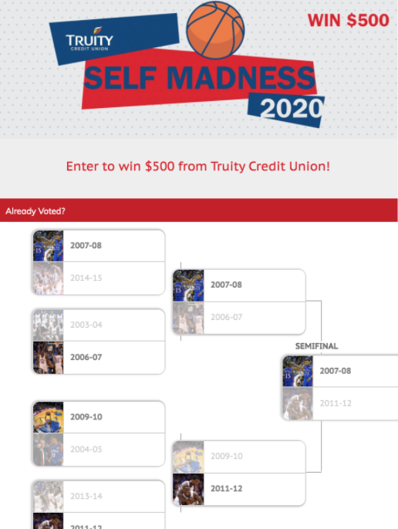
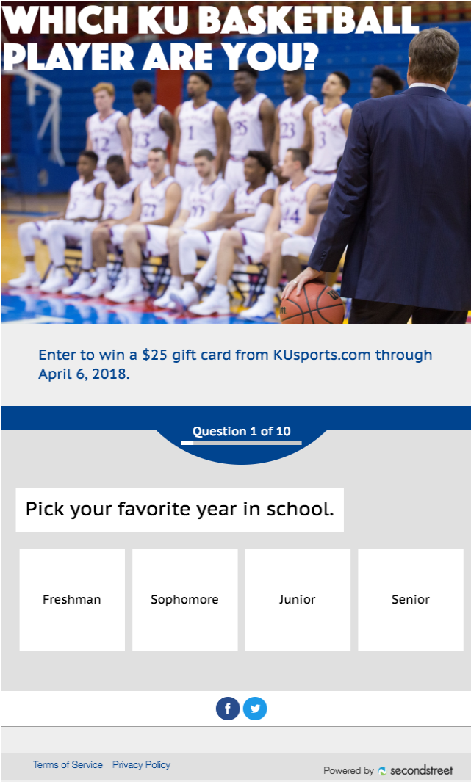


Bundle to Retain Revenue
College Hoops Bracket
$5,000 National Sweepstakes from Second Street
Fan Voting Bracket
Quiz
Polls
Limited Series Email Newsletter

Slide 25
How to Sell

Slide 26
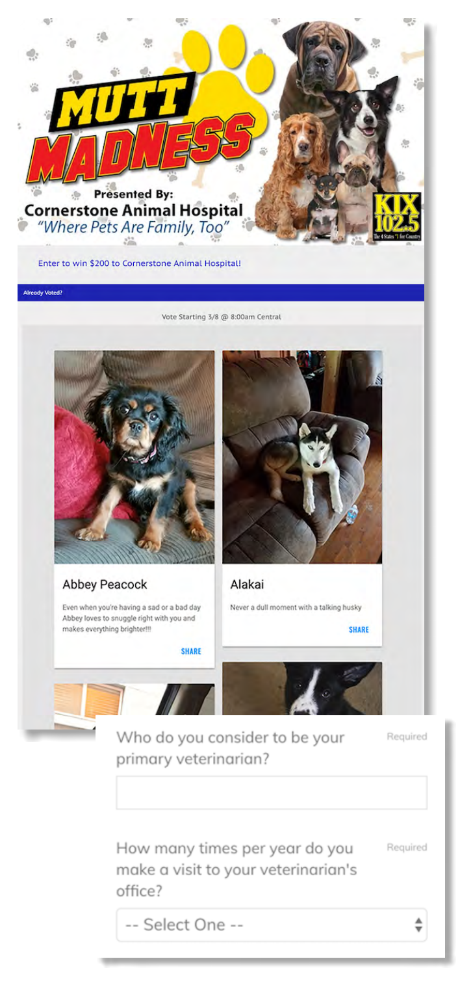
Sell the Benefits
#secondstreetlab @secondstreet
Grow email database
Grow social engagement
Branding
Highly engaged audience
Generate leads
Collect data

Slide 27

Two Ways to Sell Basketball
Exclusive Sponsor:
One advertisers owns the program
Great starting off point for beginners
Ability to charge premium rate
Ability for sponsor to add lead-gen questions to registration forms
Perfect for national/regional advertisers with larger budgets that want to reach a college hoops audience during its peak season

Slide 28
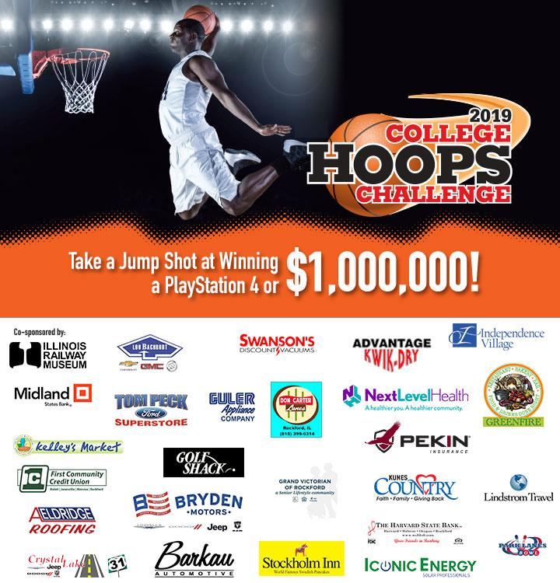
Two Ways to Sell Basketball
Multiple Sponsors:
Businesses of every size have option to participate
Can create different package tiers to generate more participation/revenue
Perfect for local SMBs that want to reach a college hoops audience

Slide 29
Who are the right advertisers to target?

Slide 30









Advertisers to Target
#secondstreetlab @secondstreet

Slide 31
Packaging & Pricing

Slide 32
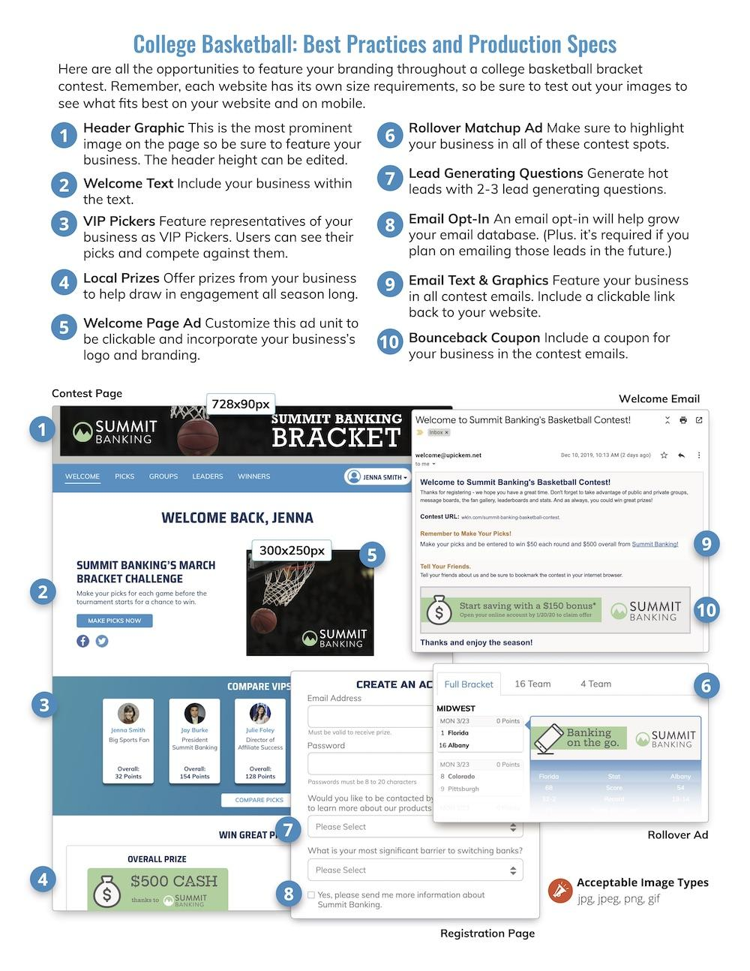
Packaging and Pricing
#secondstreetlab @secondstreet
Bundle several promotion types
Spread sponsorship out over several months
Integrated package that includes:
  Digital
  Core product
  Email

Slide 33
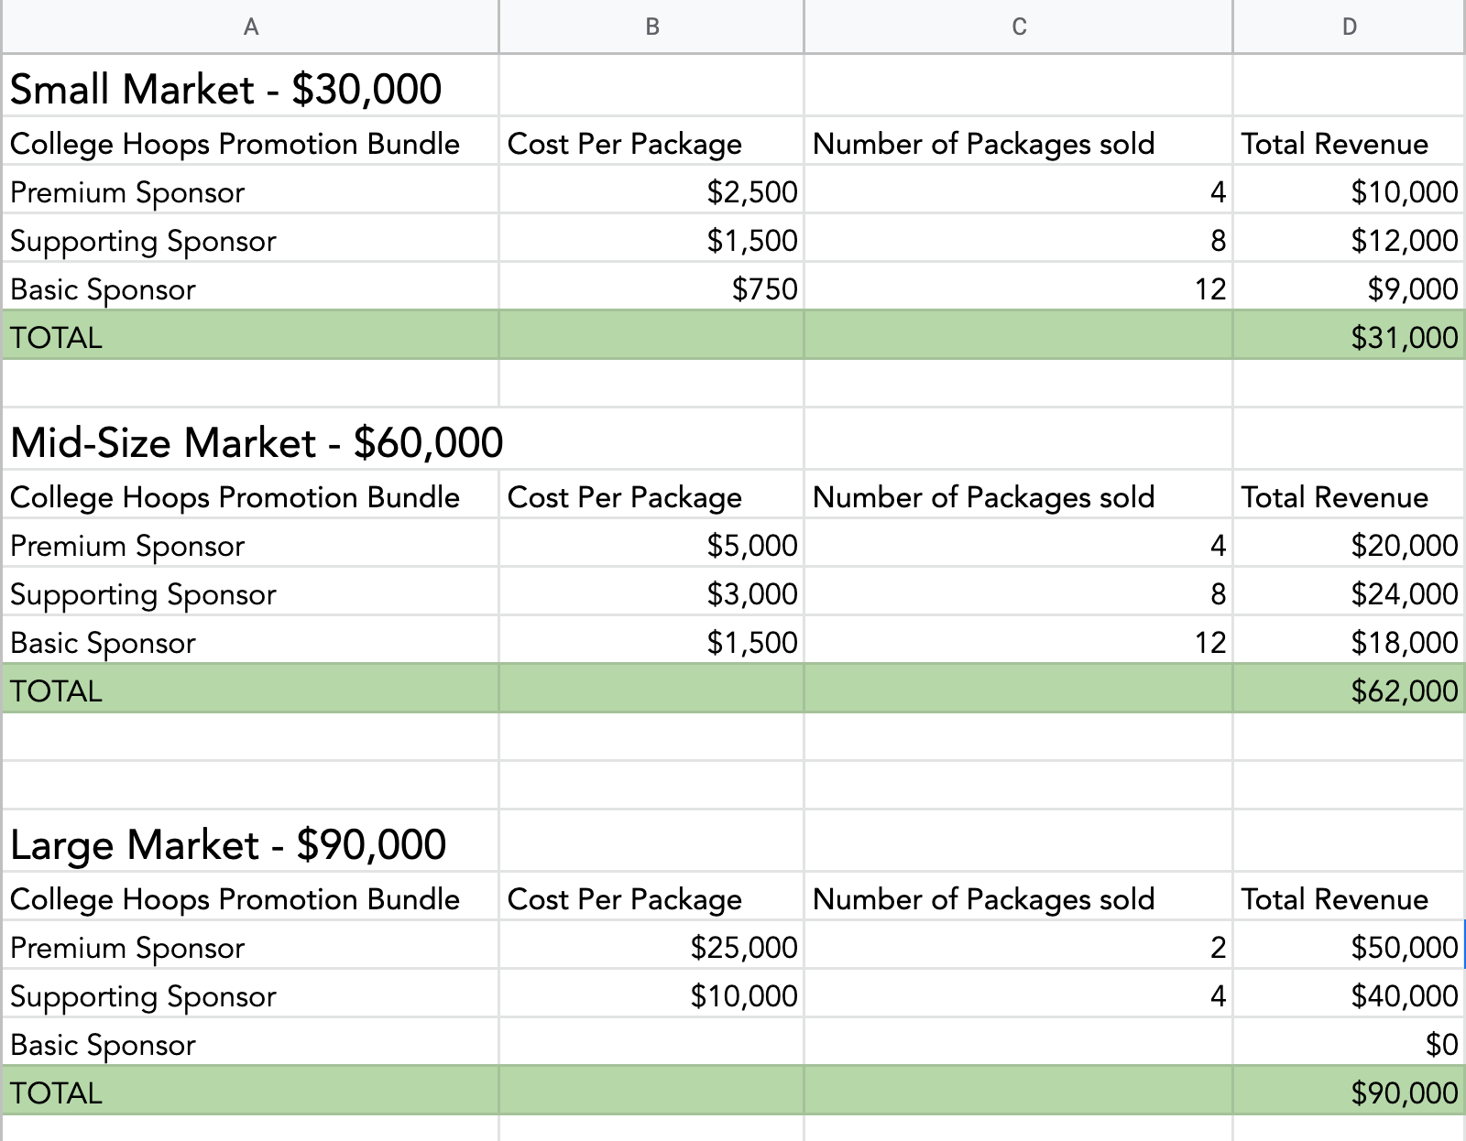
Revenue Worksheet
Use to build your perfect package and hit revenue goals!

Slide 34
Case Studies

Slide 35
College Hoops Pick’Em

Slide 36
March Mania Pick-It
Spectrum Reach | San Antonio, TX
4 weeks of revenue
Auto dealer as title sponsor
$134,000 revenue

Slide 37
College Hoops Challenge
Rockford Register Star | Rockford, IL
3 month packages vs. “one off campaign”
  Multiple sponsors
$76,000 revenue

Slide 38
Quizzes

Slide 39
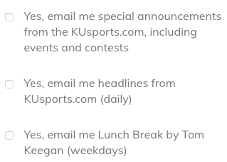
Which KU Basketball Player Are You?
Lawrence Journal-World | Lawrence, KS
4,500+ entries
1,500+ opt-ins
Used to build sport site’s email list

Slide 40
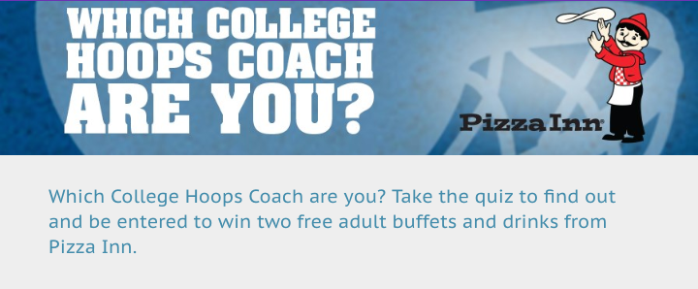
Which College Hoops Coach Are You?
WPSD-TV| Paducah, KY
515 entries
363 opt-ins
Sponsored by local pizza restaurant

Slide 41
Sweepstakes

Slide 42
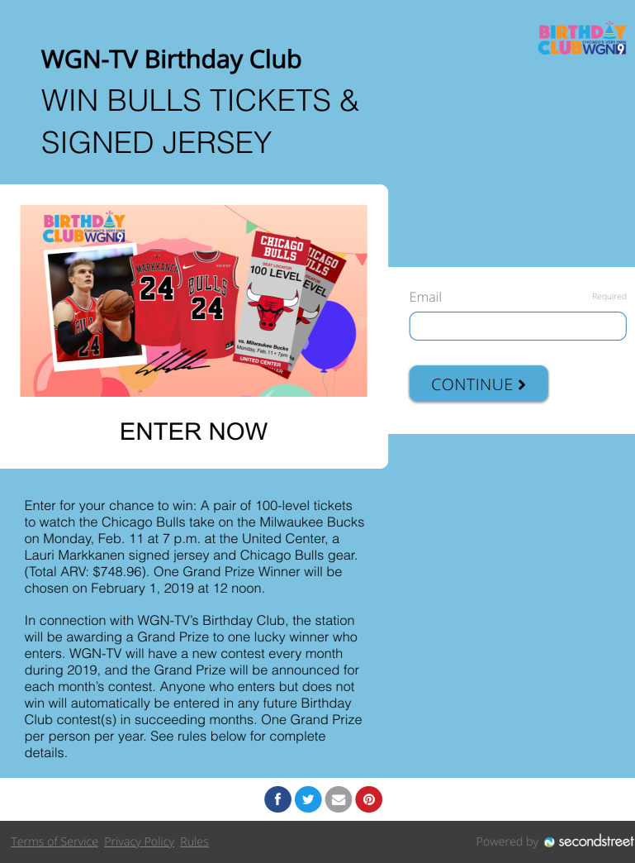
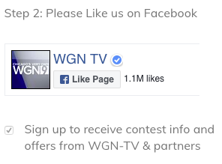
Bulls Tickets Giveaway
WGN-TV | Chicago, IL
Used to help grow internal birthday club list
14,285 entries / new emails
Grew Facebook likes
90% opt-in rate

Slide 43
Fan Voting Brackets

Slide 44
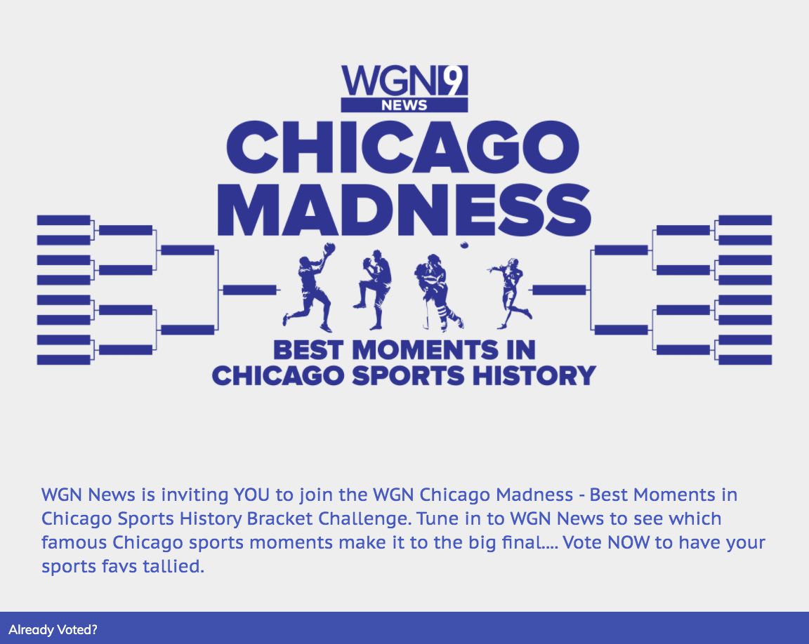
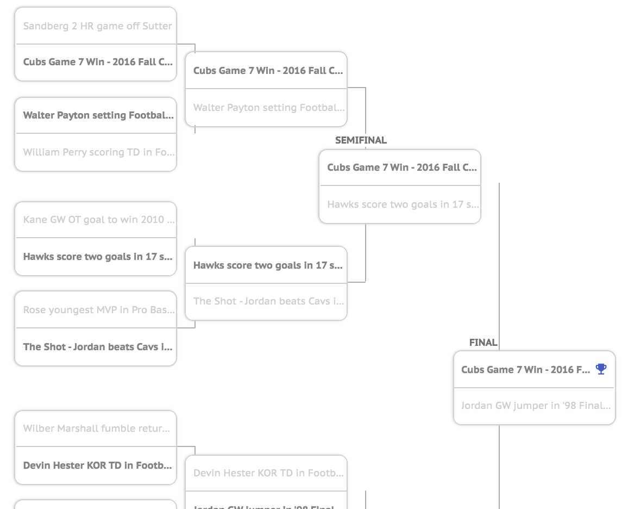
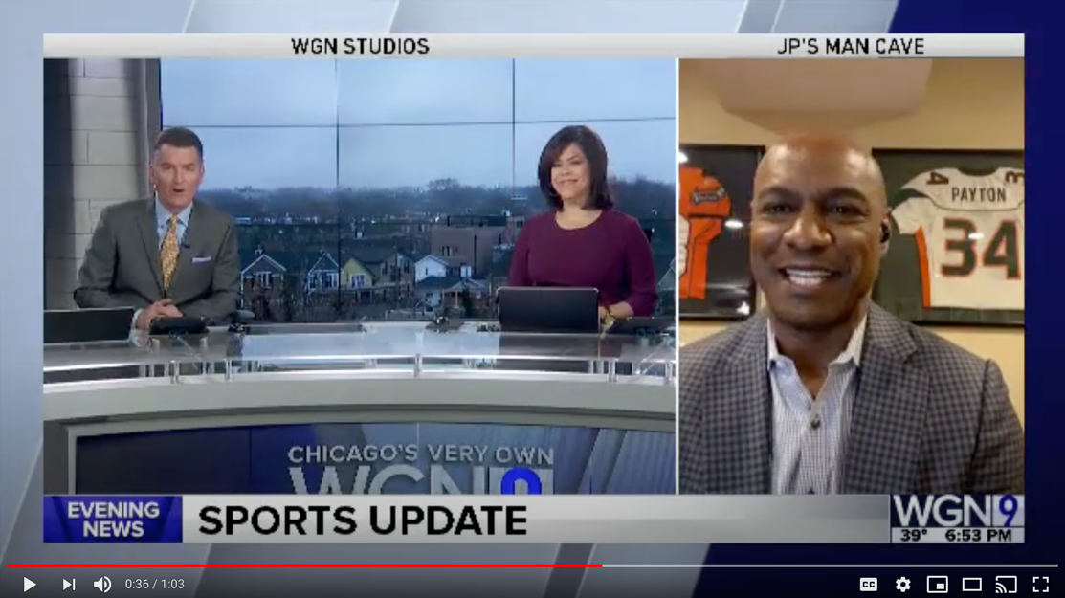
Chicago Madness
WGN-TV | Chicago, IL
Best Moments in Chicago Sports History
Daily on-air coverage!
21,700 votes
1,400+ birthday club opt-ins
670+ opt-ins for Daily News list

Slide 45

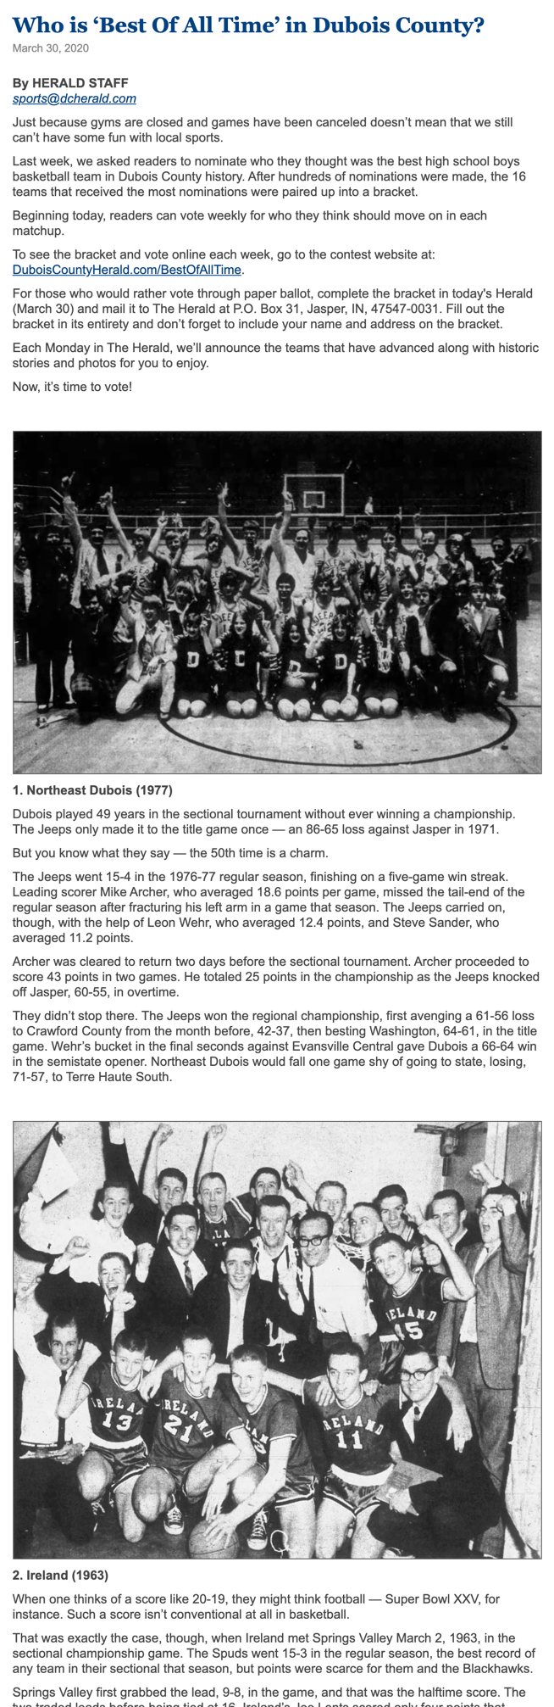
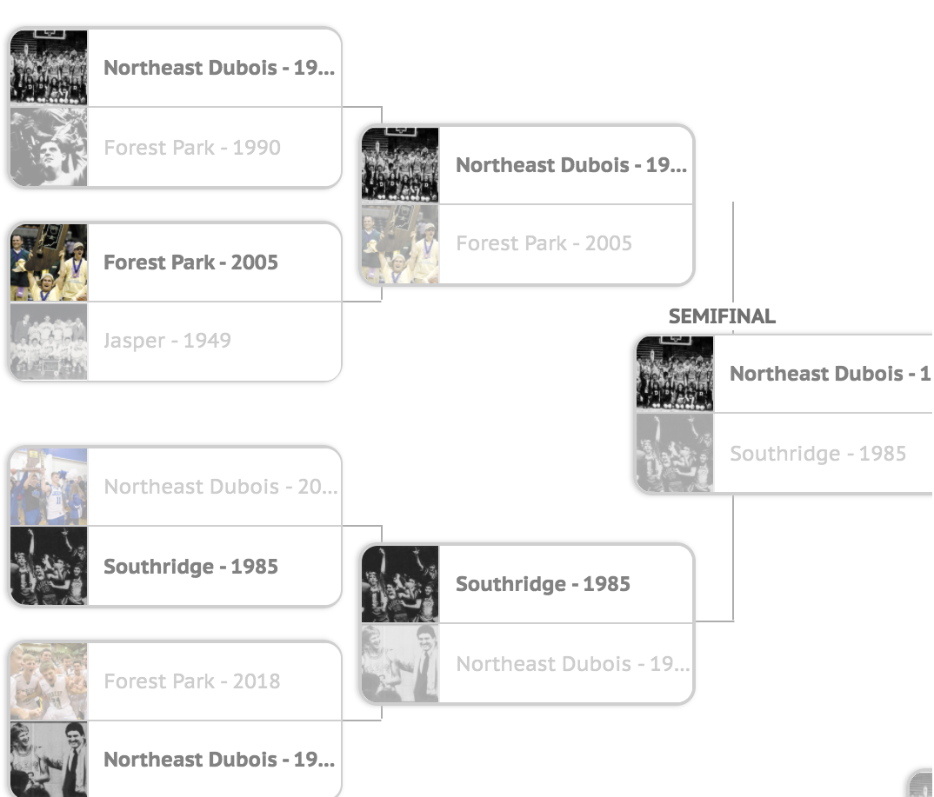
Best Of All Time Bracket
The Herald | Jasper, IN
Leveraged all content and photos from their newspaper archive
Local high school basketball moments dating back to 1949
Engaged sports audience in lieu of basketball tournament in 2020

Slide 46
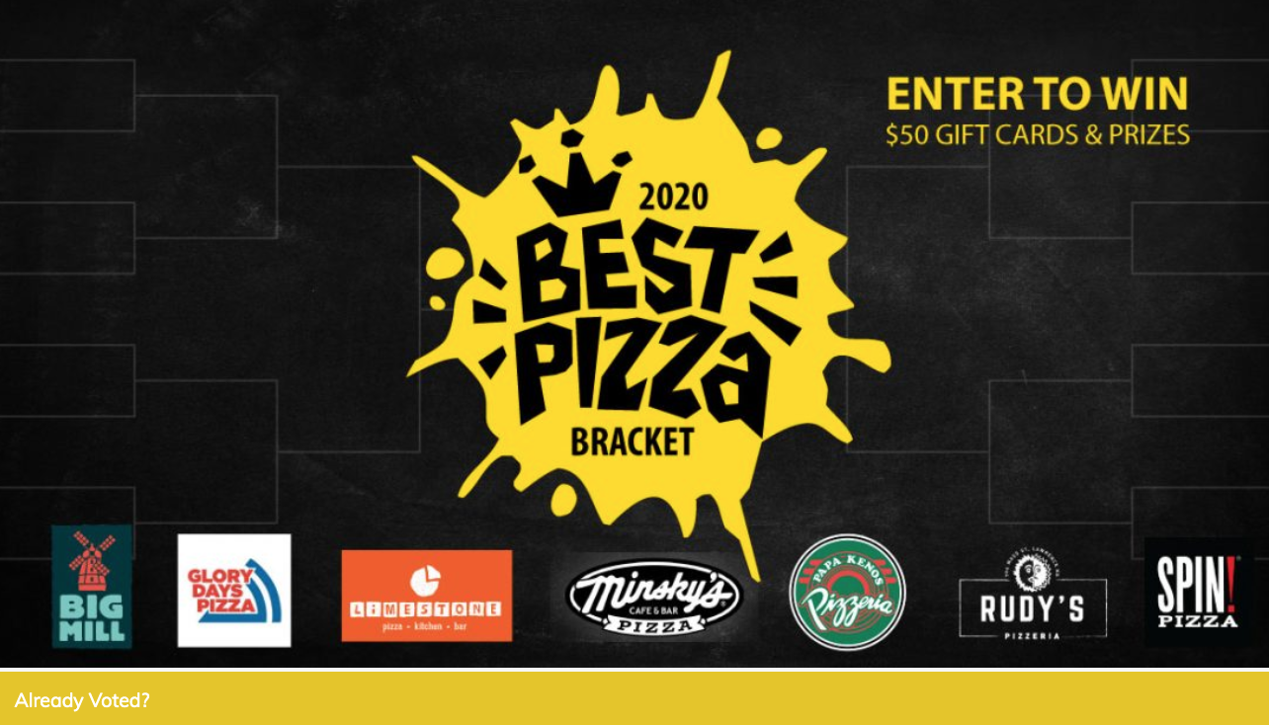
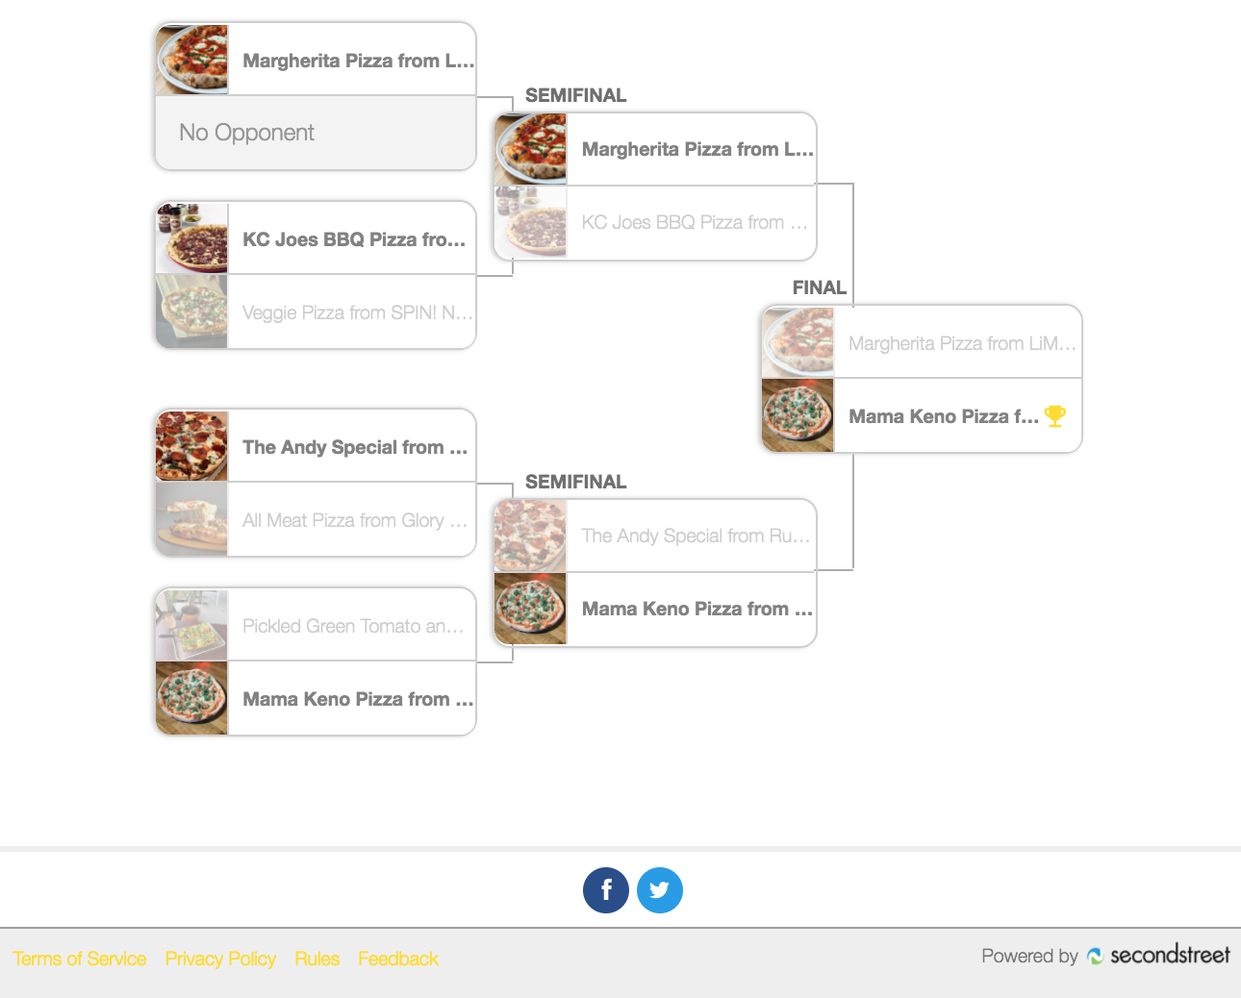
2020 Best Pizza Bracket
Lawrence Journal-World | Lawrence, KS
2,000 votes
Wanted to encourage people to order pizza online since many dining rooms were closed last year
Each restaurant sponsor provided a prize
Revenue:
  $200 per sponsor
  $1,400 overall

Slide 47
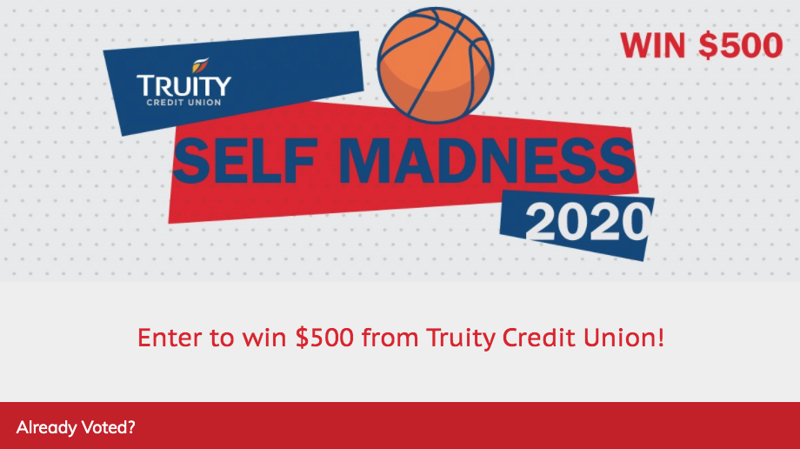
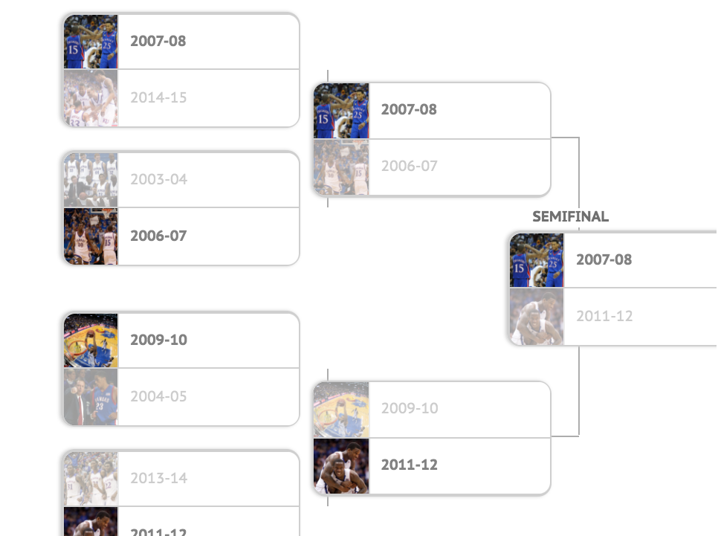
Truity Credit Union Self Madness 2020
Lawrence Journal-World | Lawrence, KS
Sponsored by Truity Credit Union
  Pick your favorite basketball teams over the years
5,000+ votes
330+ opt-ins for KU Sports list
101 opt-ins for credit union
$5,000 revenue

Slide 48
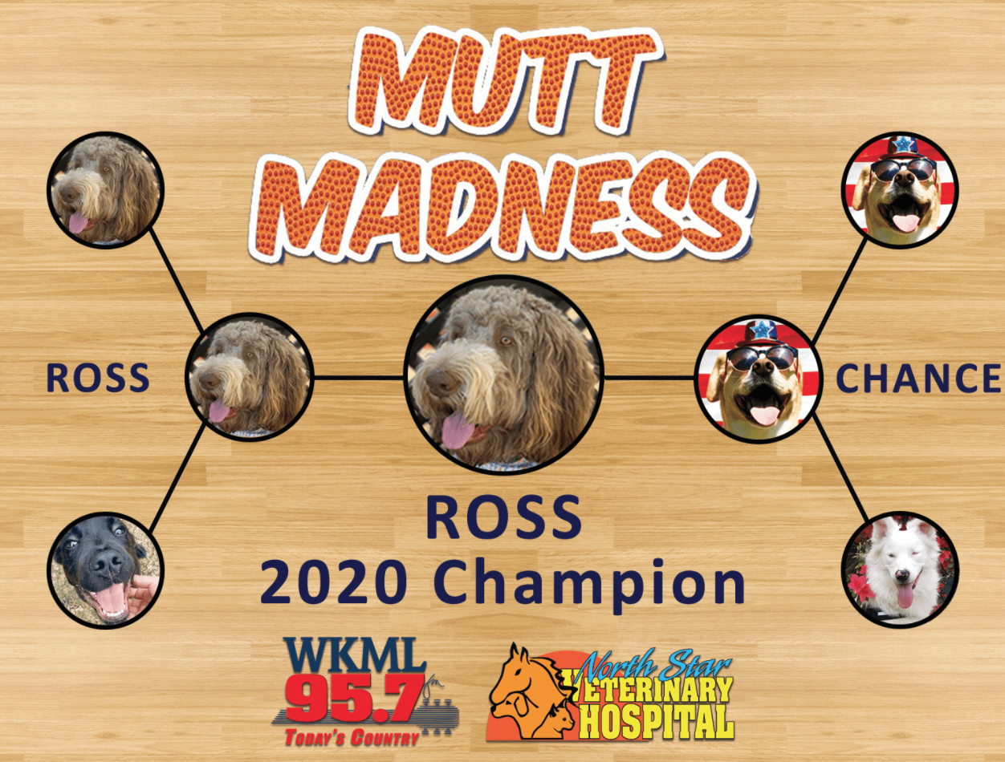
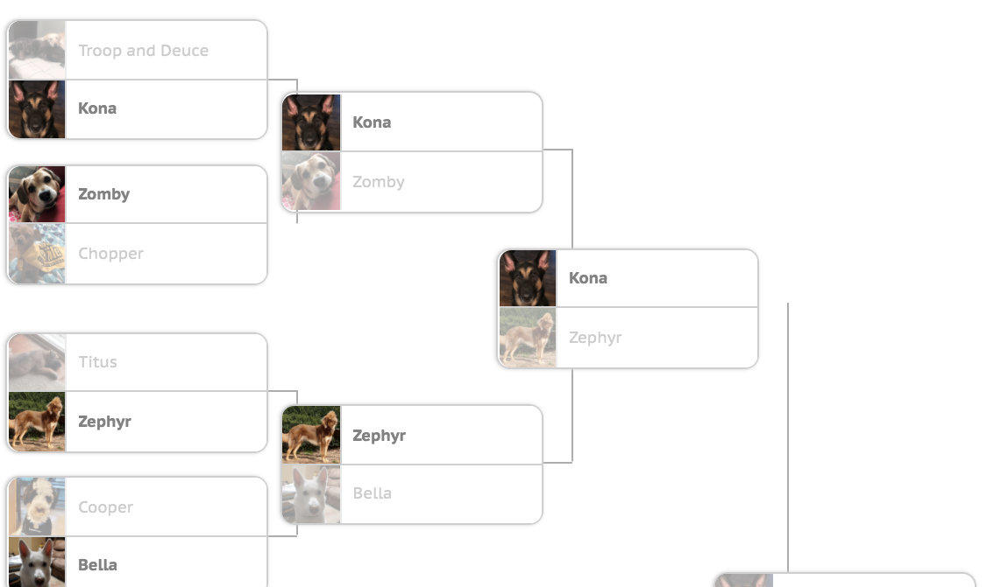
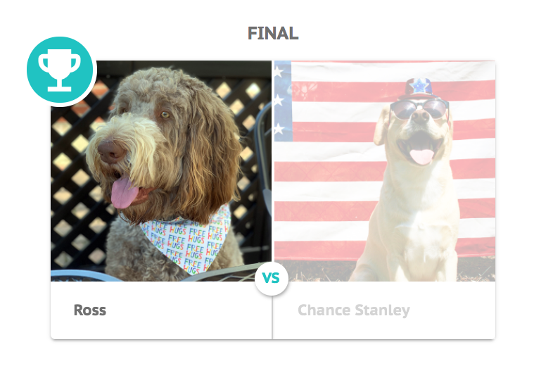
Mutt Madness
Beasley Fayetteville | Fayetteville, NC
Second year of doing Mutt Madness
Same title sponsor both years!
5,200+ votes
46 opt-ins for North Star Veterinary Hospital
$15,000 revenue

Slide 49
Your Revenue Plan

Slide 50
$15K Revenue Plan
#secondstreetlab @secondstreet
Campaign | February | March | April
College Hoops Bracket |  | 5,000 | 5,000
Watch Party at Home Giveaway |  | 2,500
Basketball Trivia Quiz Bundle (3) | 2,500
TOTAL |  |  | $15,000

Slide 51
$30K Revenue Plan
#secondstreetlab @secondstreet
Campaign | February | March | April
College Hoops Bracket |  | 7,500 | 7,500
Watch Party at Home Giveaway |  | 5,000
Basketball Trivia Quiz Bundle (3) | 5,000
Fan Voting Bracket |  | $5,000
TOTAL |  |  | $30,000

Slide 52
$50K Revenue Plan
#secondstreetlab @secondstreet
Campaign | February | March | April
College Hoops Bracket |  | $10,000 | $10,000
Watch Party at Home Giveaway |  | $7,500
Basketball Trivia Quiz Bundle (3) | $5,000
Fan Voting Bracket |  | $10,000
Fan Fever Photo Contest |  | $7,500
TOTAL |  |  | $50,000

Slide 53
Resources

Slide 54
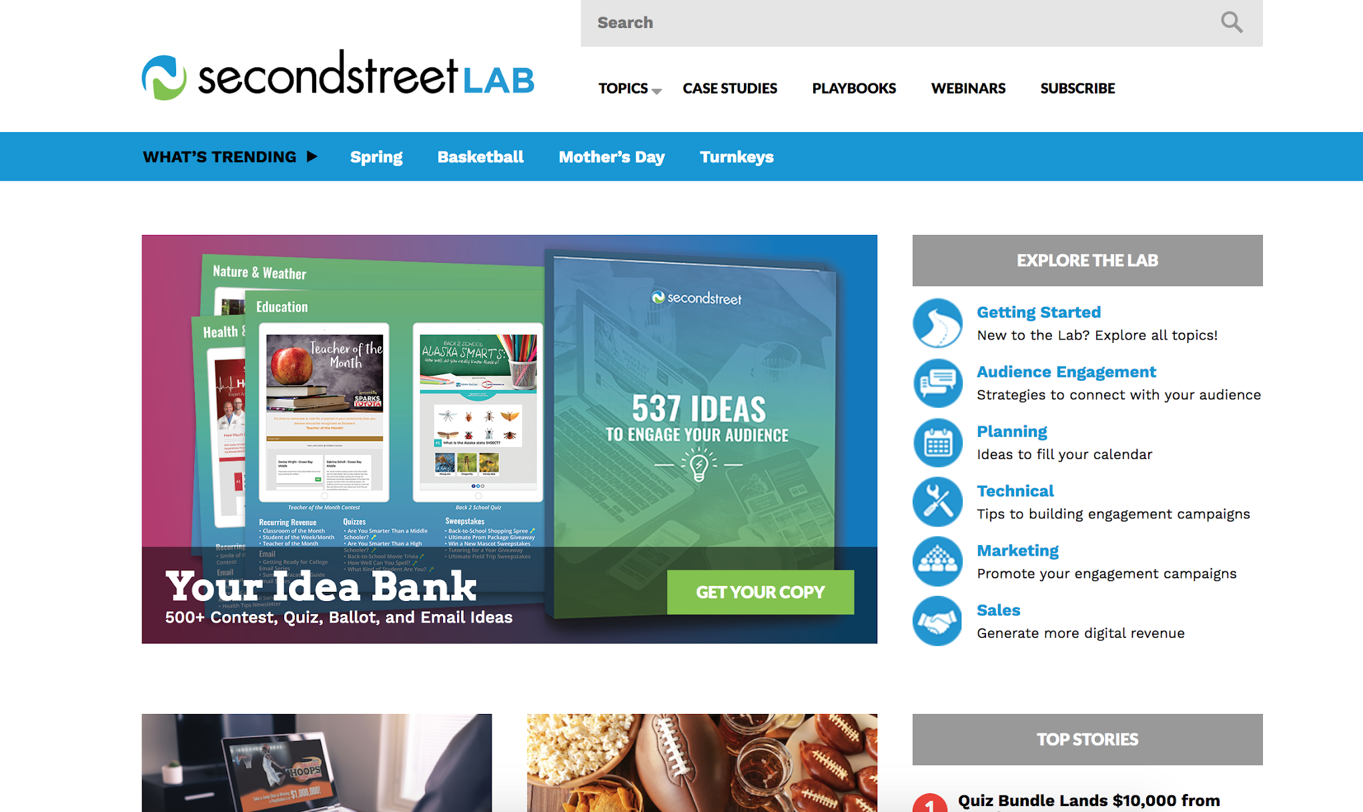
Second Street Lab
lab.secondstreet.com

Slide 55
Chat NOW with Success!
lab.secondstreet.com
9 am - 5 pm CT, Monday through Friday

Slide 56

Basketball Playbook
secondstreet.com/bball

Slide 57
Basketball Production Specs
secondstreet.com/saleskits

Slide 58
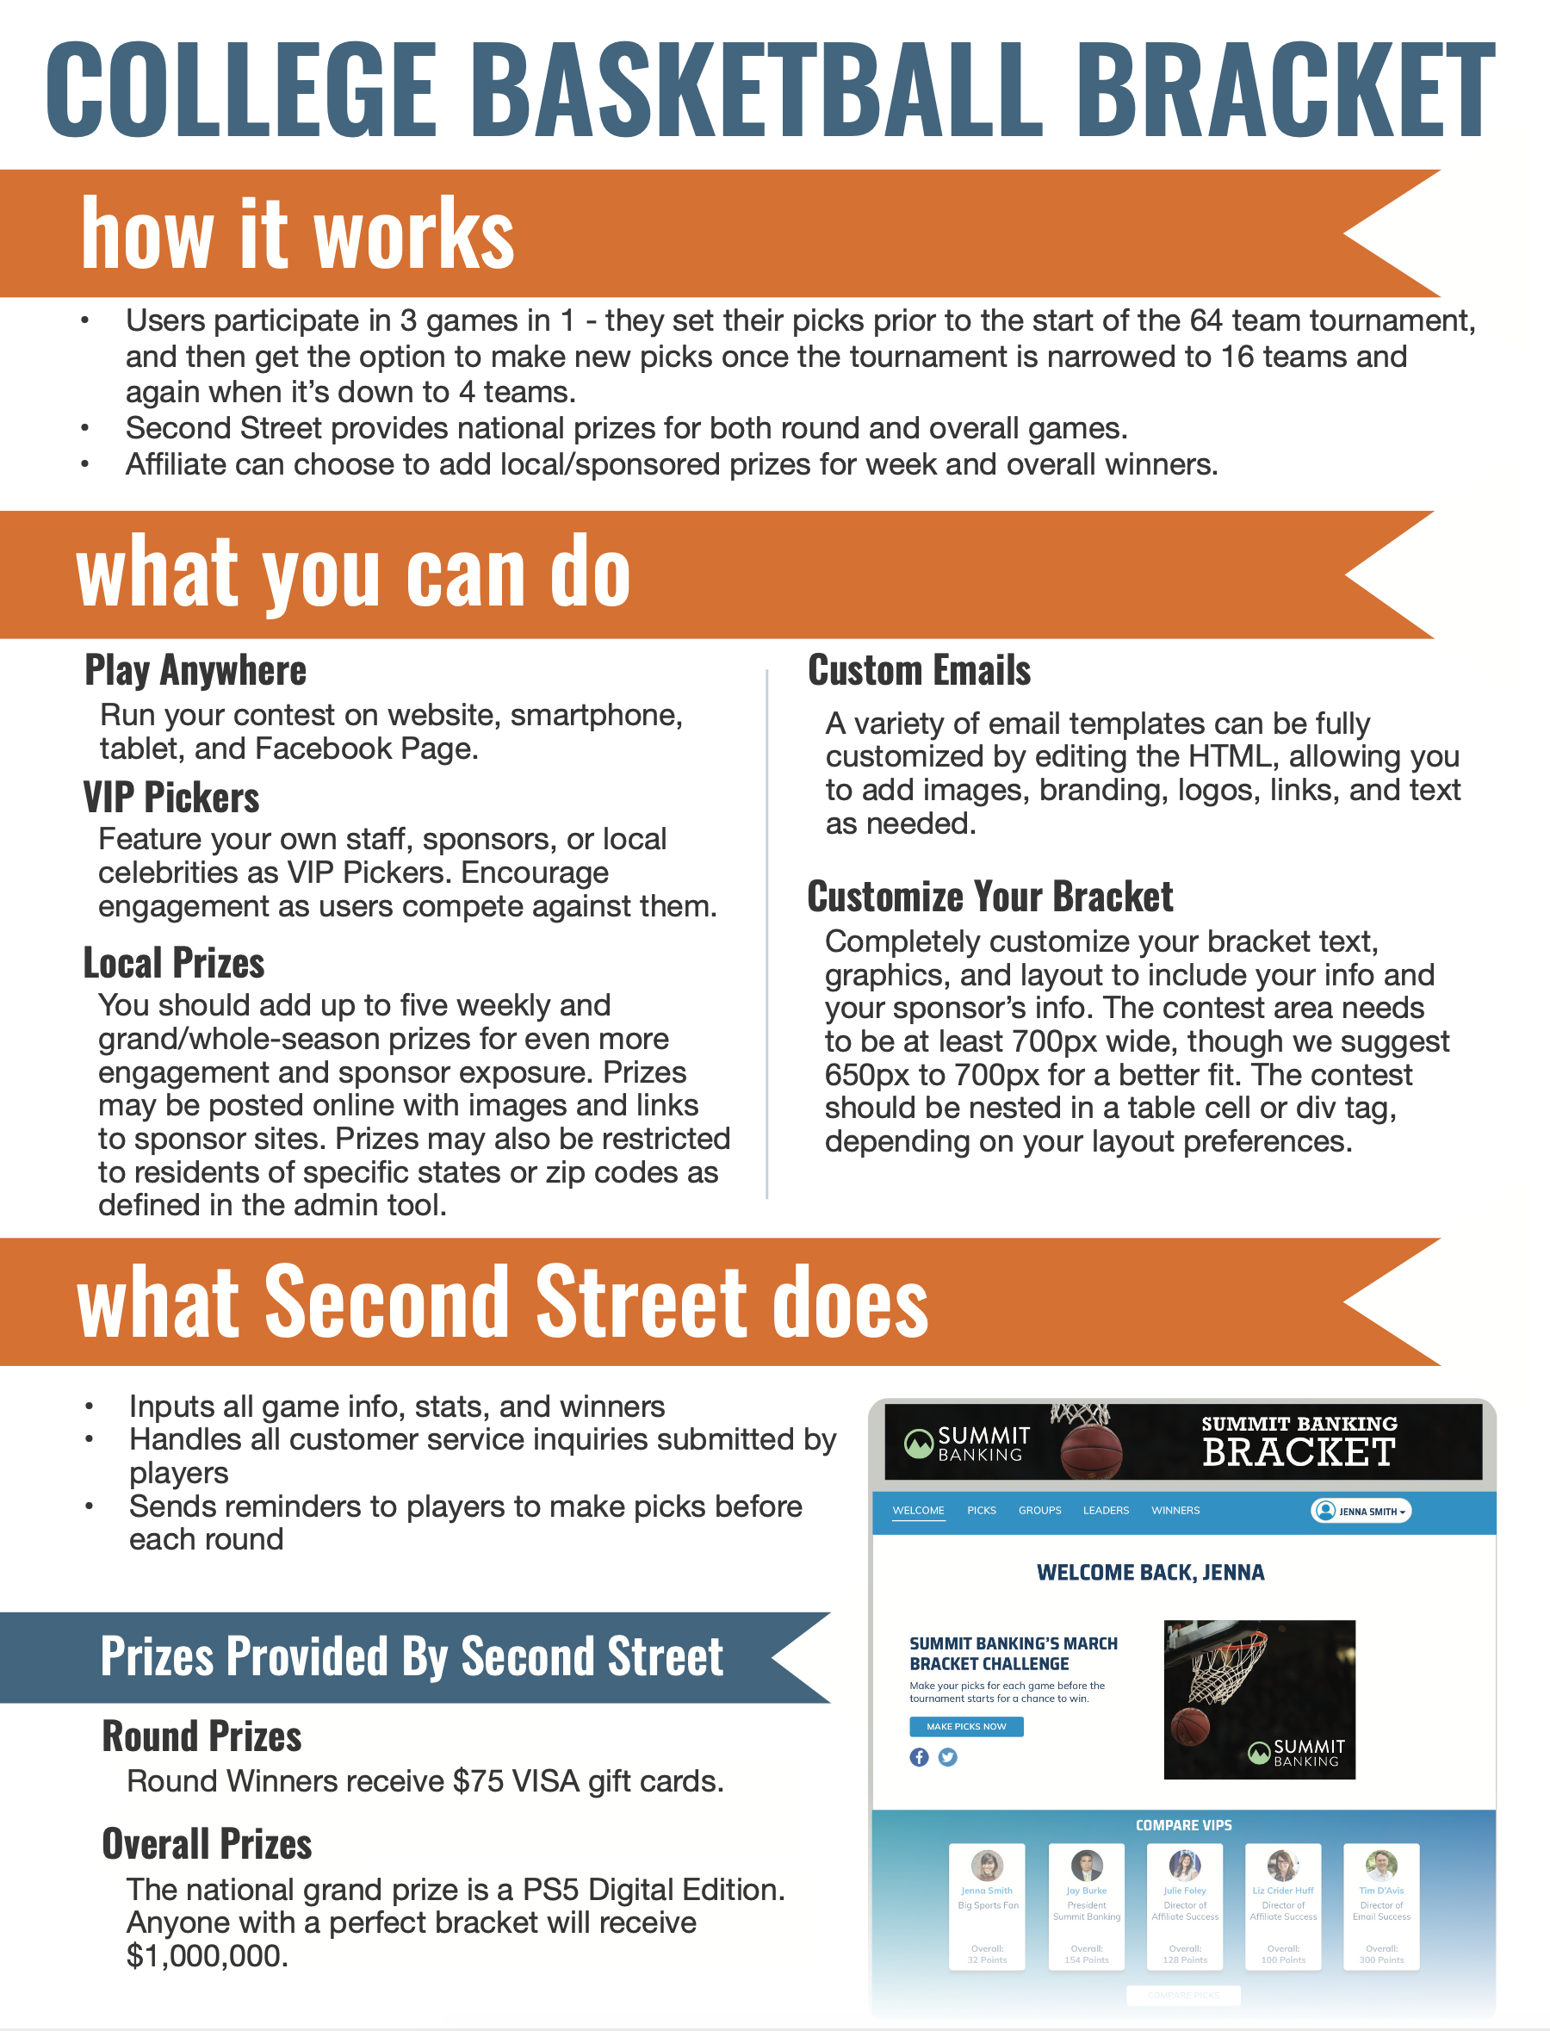
Scope of Game
secondstreet.com/saleskits

Slide 59
Revenue Worksheet
secondstreet.com/basketball-worksheet

Slide 60

Basketball Office Hours
Creating the BEST Basketball Program
Wednesday, January 27
Time: 2PM - 2:30PM ET
secondstreet.com/office-hours

Slide 61
Thank You!
Liz Huff
Julie Foley
Director of Affiliate Success
Director of Affiliate Success
liz@secondstreet.com
julie@secondstreet.com

